Slide 1
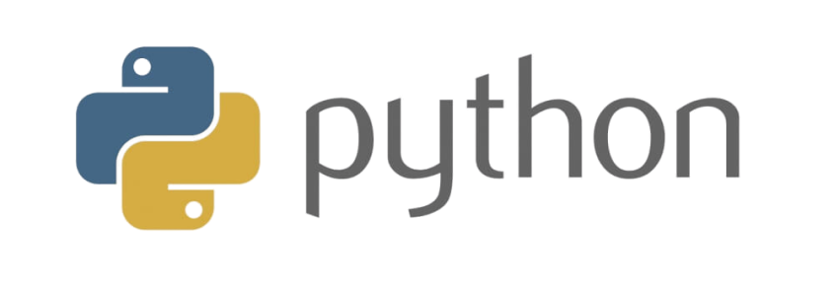
Learn with Ajay Day 1 - Lesson – 1 Introduction to Python

Slide 2
Learn with Ajay Day 2 - Lesson – 2 Download & Install Python

Slide 3
Learn with Ajay Day 3 - Lesson – 3 1st Python Program

